Slide 1
Vizualizations
File created on: 10/15/24 10:36:07 AM CDT

Slide 2
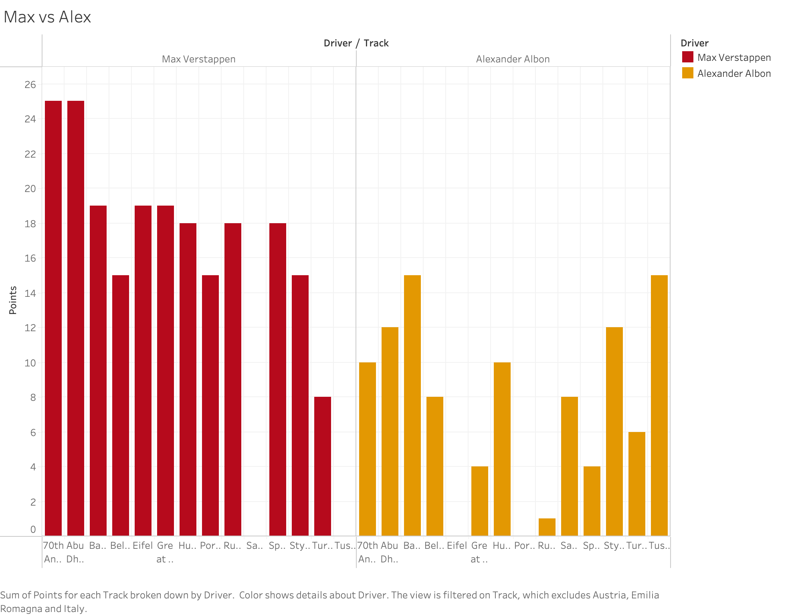

Slide 3
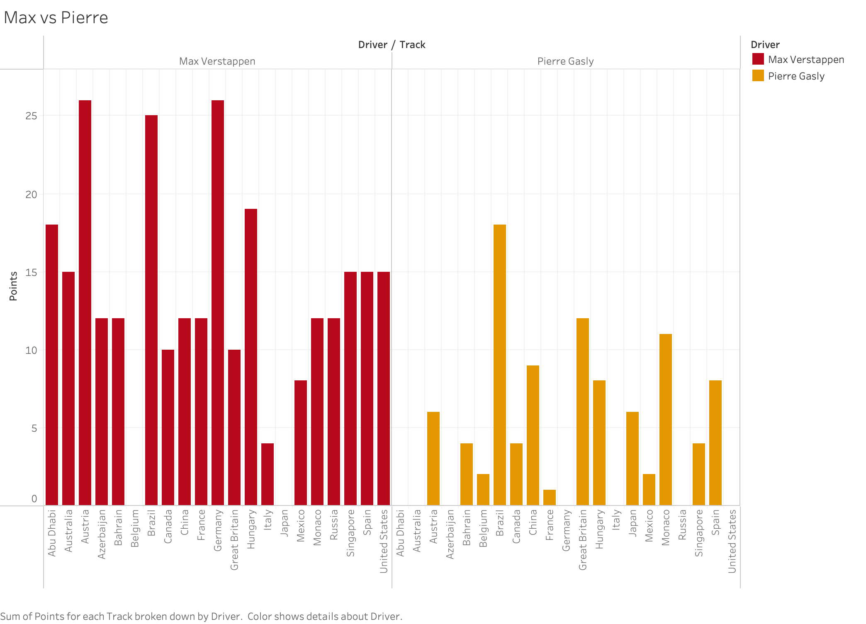

Slide 4
